Slide 1
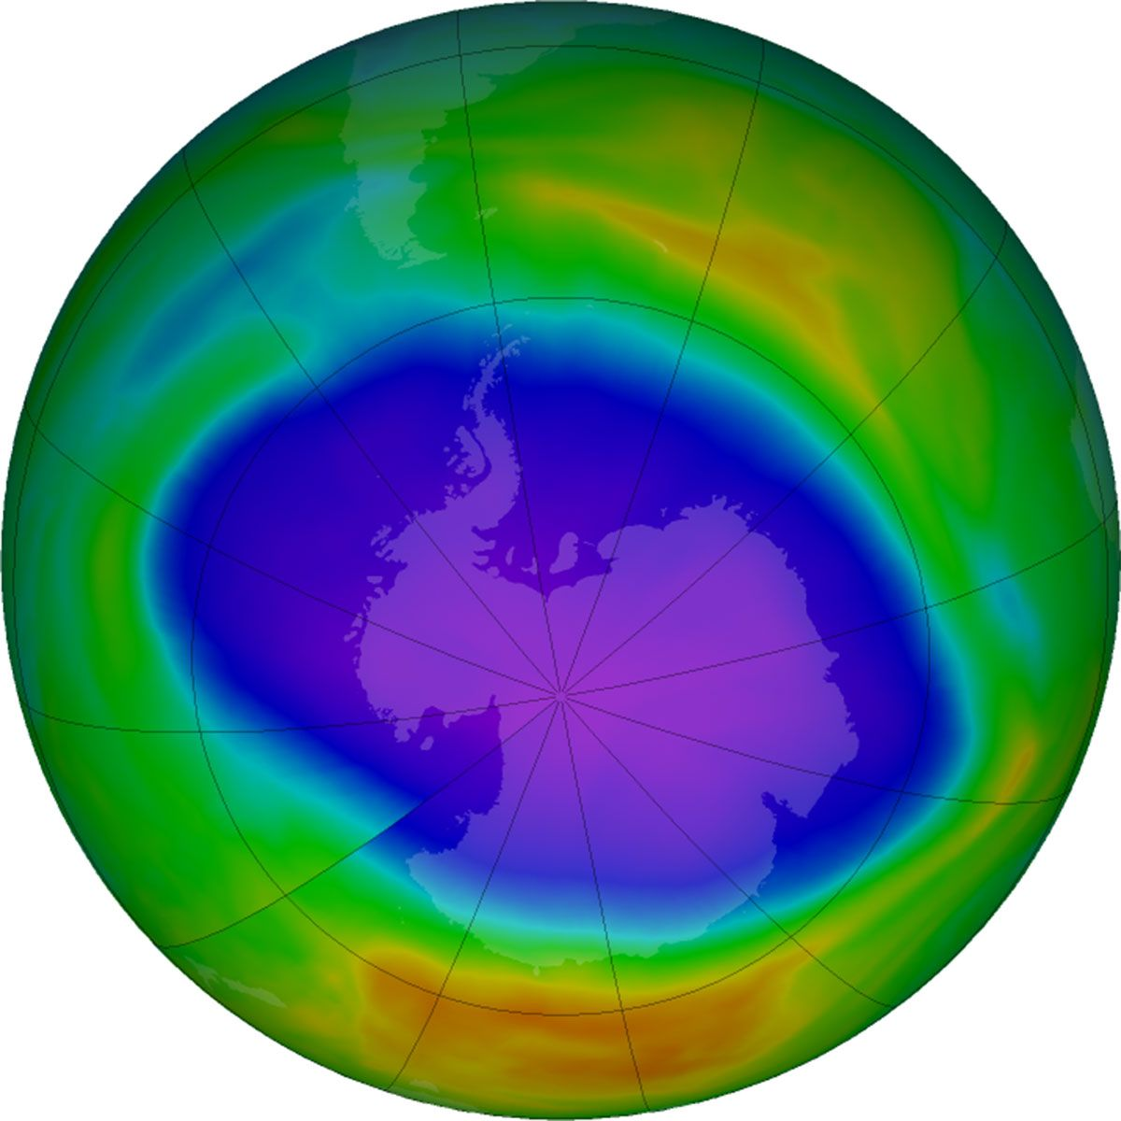
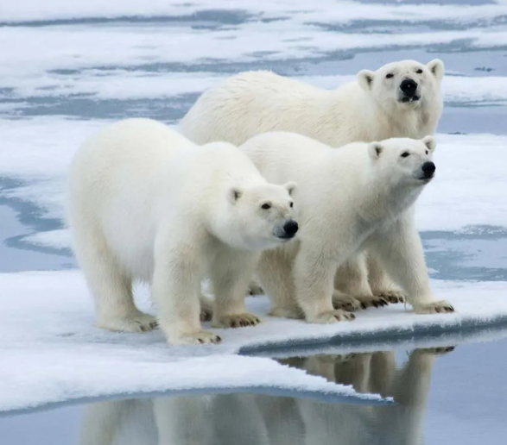
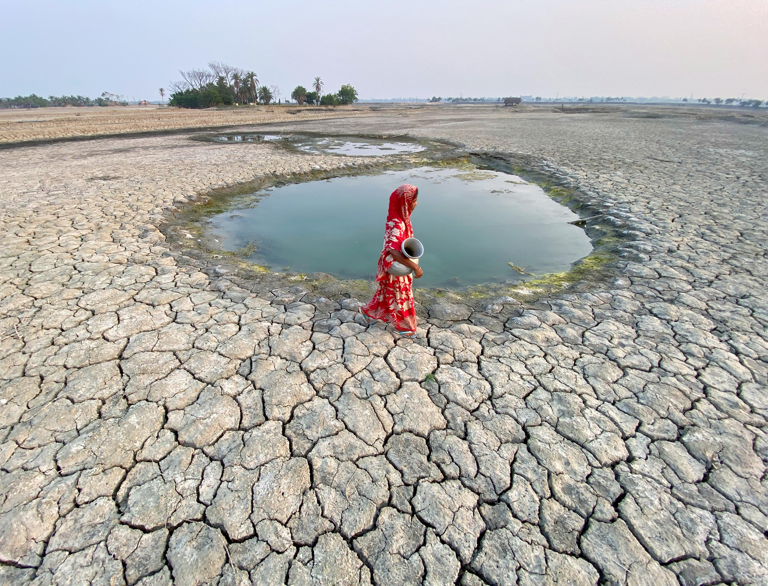
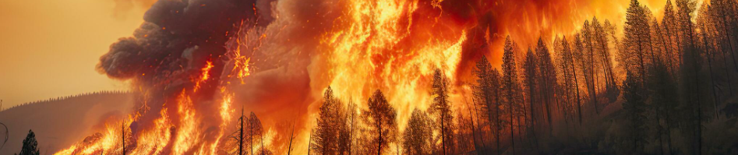
Lesson 2: Climate Change and Global Warming
Notes:
Instructor Notes: Verbatim Guidance: “Greetings, students. Today’s lesson is about climate change and global warming — topics that are affecting the Earth right now. We’ll understand how human actions have changed the environment and what we can do to help."
Background Information: Introduce the urgency of the issue, connecting students’ observations (e.g., hotter summers, floods) to larger global changes.
Structure Mapping: Introduction

Slide 2







Learning Objectives
Define climate change and global warming
Understand the greenhouse effect and key gases
Explore the impacts on weather, agriculture, and sea levels
Identify mitigation strategies, including local and Islamic perspectives
Notes:
Instructor Notes: Verbatim Guidance: "By the end of this lesson, you’ll understand how global warming works, how it affects us, and what solutions are being used around the world and here in Saudi Arabia."
Structure Mapping: Learning Objectives

Slide 3

- Have you noticed any changes in weather patterns in your area? - Why is it important to learn about climate change?
Notes:
Instructor Notes: Verbatim Guidance: “Let us discuss.”

Slide 4

What Is Climate Change vs. Global Warming?
Climate change = long-term shifts in weather patterns
Global warming = rise in Earth’s average temperature
Both are linked to human activity
Notes:
Instructor Notes: Verbatim Guidance: "Global warming is one part of climate change. While the planet’s temperature rises, we also see changes in rainfall, stronger storms, and more extreme weather."
Background Information: Clarify that climate change includes cold extremes, droughts, and floods, not just warming.
Discussion Prompts: • Can cold weather still happen during global warming? • How might these changes affect Saudi Arabia?
Structure Mapping: Presentation of New Content

Slide 5

Greenhouse Effect and Human Causes
What activities in daily life produce greenhouse gases?
The natural greenhouse effect keeps Earth warm
Human activities increase greenhouse gases (CO₂, CH₄, N₂O)
Major sources: fossil fuels, deforestation, industry, agriculture
Notes:
Instructor Notes: Verbatim Guidance: "Greenhouse gases like carbon dioxide trap heat in our atmosphere. But too much of these gases makes Earth too warm — a problem caused by pollution, cutting forests, and burning fuels."
Background Information: Explain natural vs. enhanced greenhouse effect, with visuals for clarity.
Discussion Prompts: • Why do trees help reduce global warming? • What activities in daily life produce greenhouse gases?
Structure Mapping: Presentation of New Content

Slide 6
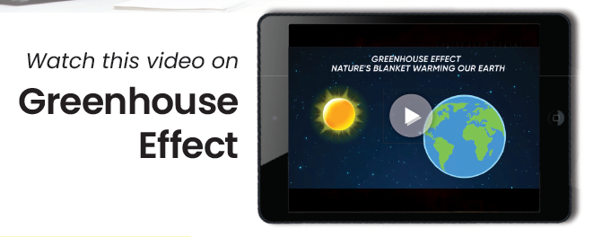
Notes:
Link: https://learn.kodeit.com/go/y5gw4h

Slide 7
Climate Change Impacts – Weather and Water
Heatwaves: More frequent and intense
Storms: Stronger hurricanes, typhoons
Droughts and Floods: Erratic rainfall patterns
Sea-Level Rise: Melting ice and thermal expansion
Notes:
Instructor Notes: Verbatim Guidance: "As the planet warms, weather becomes more extreme. Some places get more floods, others get drier. Coastal cities risk being underwater."
Background Information: Link rising sea levels to risks for island nations and low-lying cities.
Discussion Prompts: • How would flooding affect a city near the sea? • Why are heatwaves more dangerous now?
Structure Mapping: Presentation of New Content

Slide 8
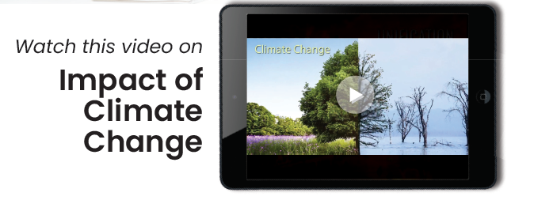
Notes:
Link: https://learn.kodeit.com/go/dja8c5

Slide 9

Agriculture and Food Security
Crop yields decrease in hotter, drier climates
Water scarcity impacts irrigation
Risk of hunger and malnutrition increases
Why is water management so critical in Saudi Arabia?
Notes:
Instructor Notes: Verbatim Guidance: "Climate change is making farming harder. Crops are failing, water is scarce, and food prices rise — affecting everyone, especially poorer countries."
Background Information: Refer to Middle Eastern water stress and international examples.
Discussion Prompts: • How does heat affect crops like wheat and rice? • Why is water management so critical in Saudi Arabia?
Structure Mapping: Presentation of New Content

Slide 10
Ecosystems and Biodiversity
Rising temperatures shift habitats
Coral reefs bleach and die
Extinction risk increases for many species
Notes:
Instructor Notes: Verbatim Guidance: "When habitats are too hot or dry, plants and animals can’t survive. Coral reefs, rainforests, and desert wildlife are all in danger."
Background Information: Mention Arabian Peninsula biodiversity, e.g., Arabian oryx or coastal mangroves.
Discussion Prompts: • Why are coral reefs important to marine life? • What species in Saudi Arabia might be at risk?
Structure Mapping: Presentation of New Content

Slide 11
Mitigation Strategies – Local to Global
Renewable energy (solar, wind, hydro)
Energy-efficient homes and transport
Reforestation and afforestation
Circular carbon economy and net-zero goals
Notes:
Instructor Notes: Verbatim Guidance: "We can slow climate change with smart solutions — clean energy, tree planting, better transportation, and more efficient technology."
Background Information: Use Saudi Vision 2030 examples — solar farms, tree planting, NEOM.
Discussion Prompts: • How does tree planting help the atmosphere? • What energy sources are sustainable?
Structure Mapping: Presentation of New Content

Slide 12
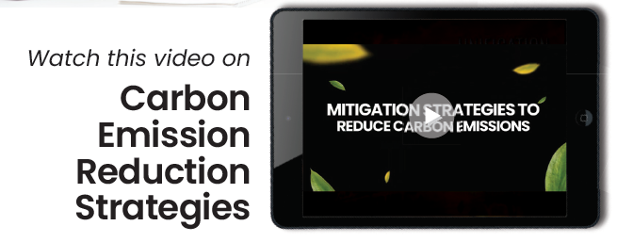
Notes:
Link: https://learn.kodeit.com/go/tpib44

Slide 13
Islamic Teachings on Climate Responsibility
Earth is a trust (Amanah) – Surah Al-Rum 30:41
Wastefulness is discouraged – Surah Al-Isra 17:27
Humans are stewards (Khilafah)
Notes:
Instructor Notes: Verbatim Guidance: "Islam teaches that Earth is a gift from Allah — and we must protect it. Wastefulness is discouraged, and we are called to act as stewards."
Background Information: Relate to Prophet Muhammad’s (PBUH) example of frugality and kindness to animals.
Discussion Prompts: • What does stewardship (Khilafah) mean in today’s world? • How can we reduce waste in our homes and schools?
Structure Mapping: Faith Integration

Slide 14
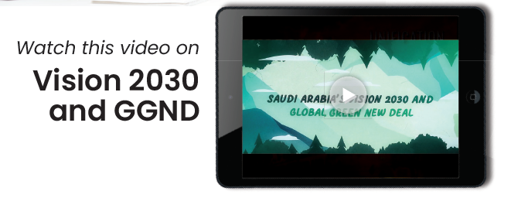
Notes:
Link: https://learn.kodeit.com/go/xod938

Slide 15
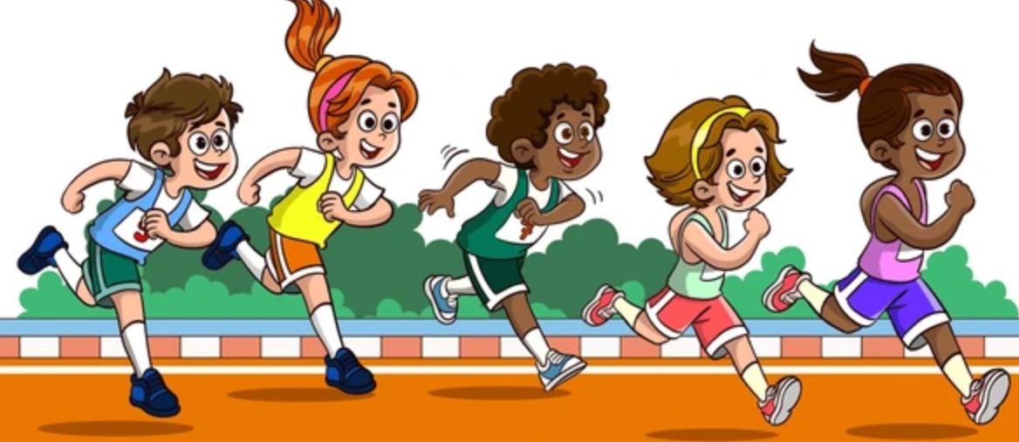
Guided Practice – Climate Action Poster
Design a poster encouraging climate action
Include: cause, effect, and one solution
Use visuals and an Islamic message
Hurry Up !!!
Glaciers are Melting
Notes:
Instructor Notes: Verbatim Guidance: "Let’s use your creativity! Make a poster that teaches others about climate change and how to help — include an Islamic quote too."
Background Information: This supports cross-curricular learning (art + science + values).
Discussion Prompts: • What’s one key message you want to share? • How can art inspire people to act?
Structure Mapping: Guided Practice / Interactive Activity

Slide 16

Check Your Understanding
What’s the difference between global warming and climate change?
Name two greenhouse gases and their sources.
How does climate change affect farming?
What does Islam teach about environmental care?
Notes:
Instructor Notes: Verbatim Guidance: "Let’s review what we’ve learned. Discuss your answers in pairs before we go through them as a class."
Structure Mapping: Assessment of Understanding

